Slide 1
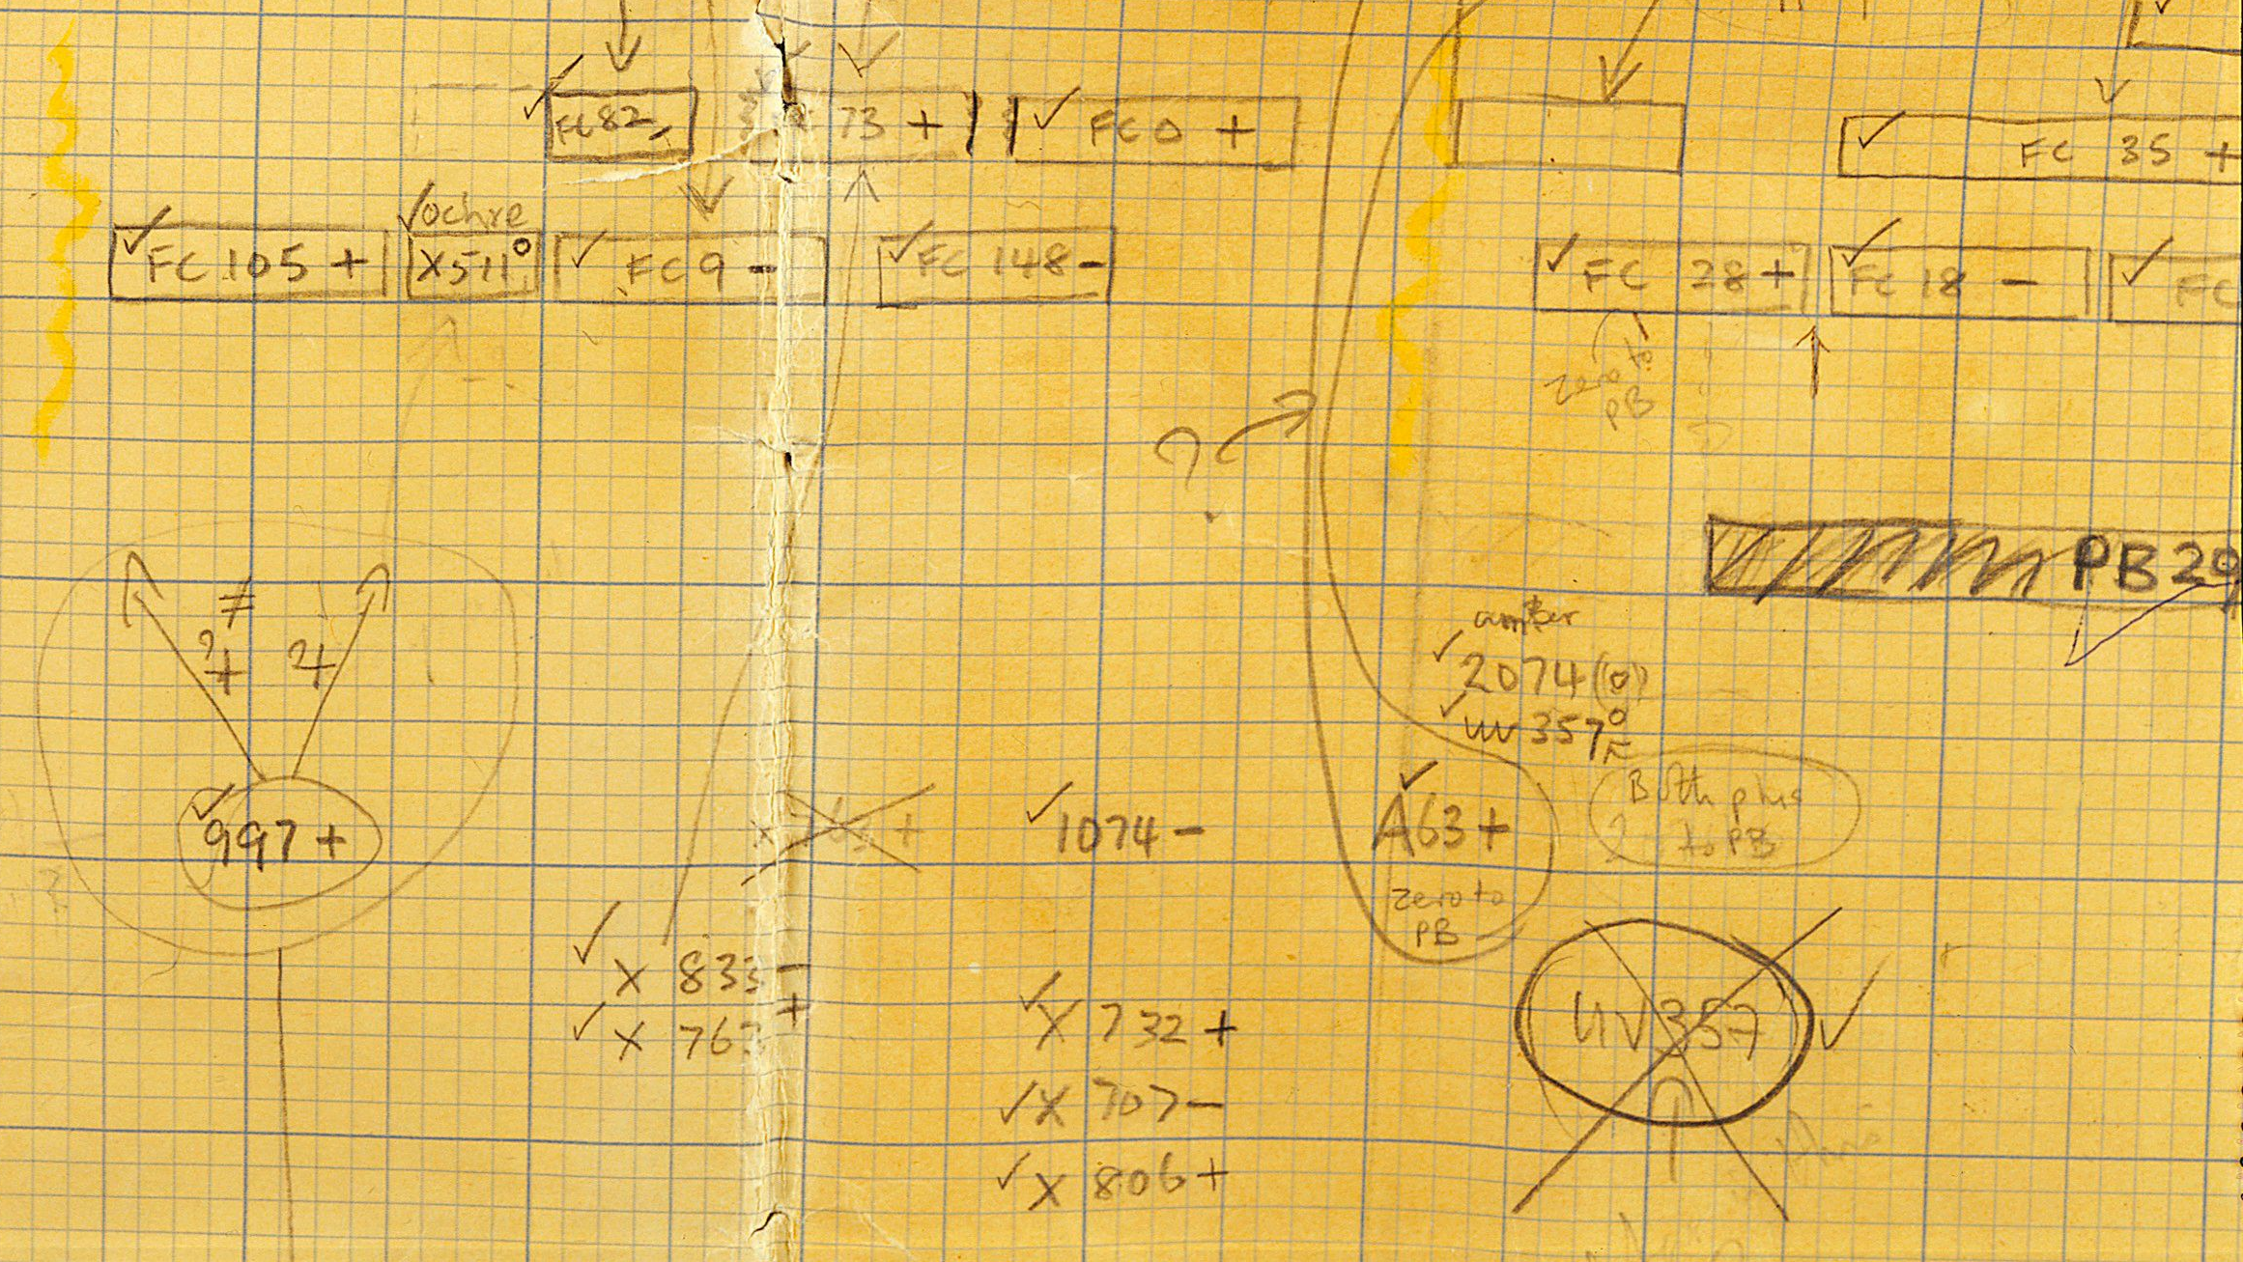
The Triplet Experiment
Lumi
10.15

Slide 2
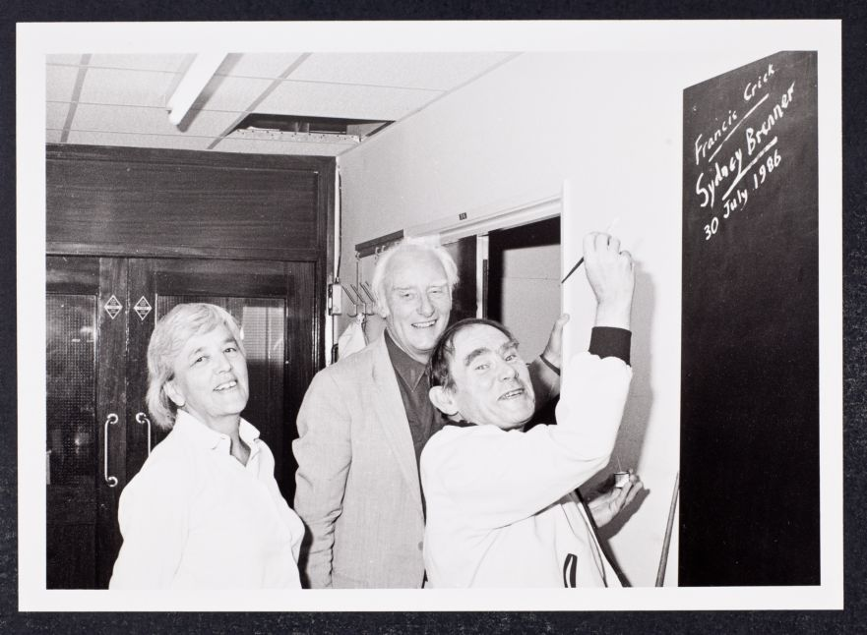
Contents
Backgrounds of the Experiment
Methods and Results of the Experiment
Aftermarks
2

Slide 3
Backgrounds
3

Slide 4
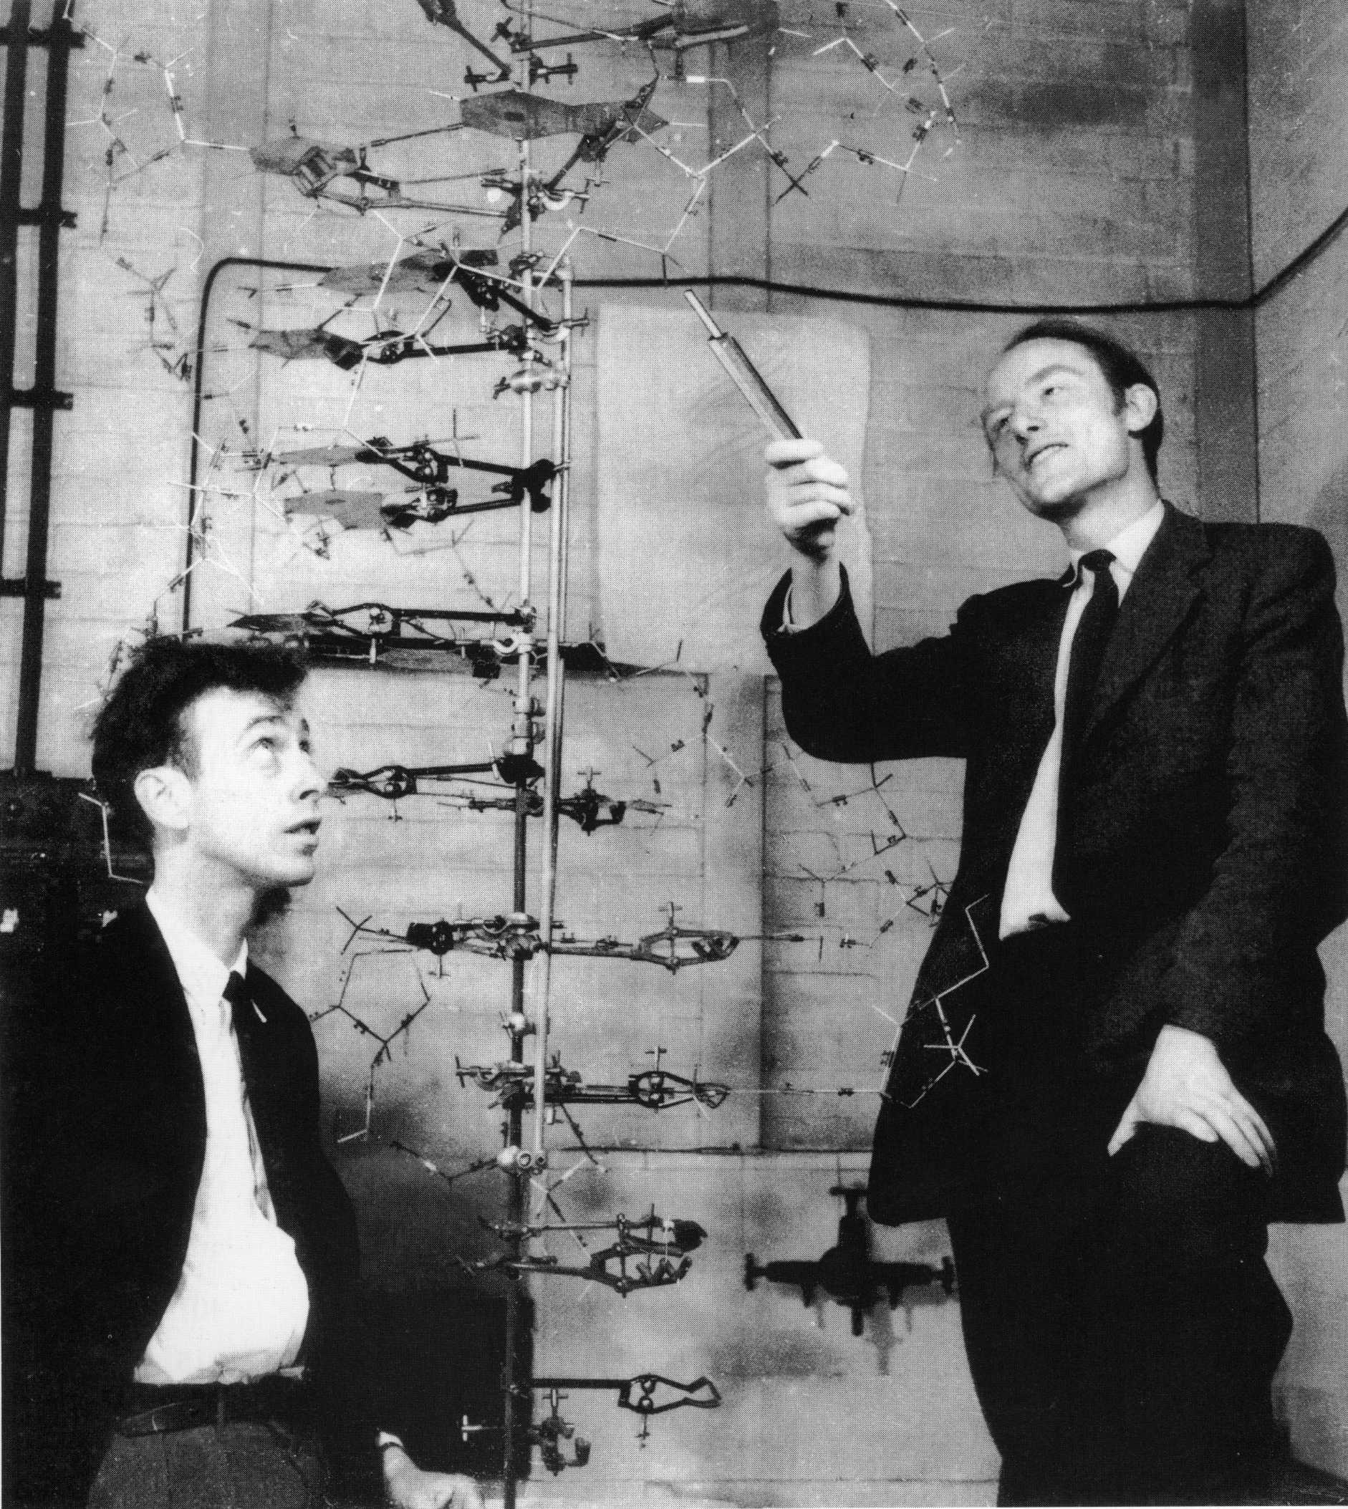
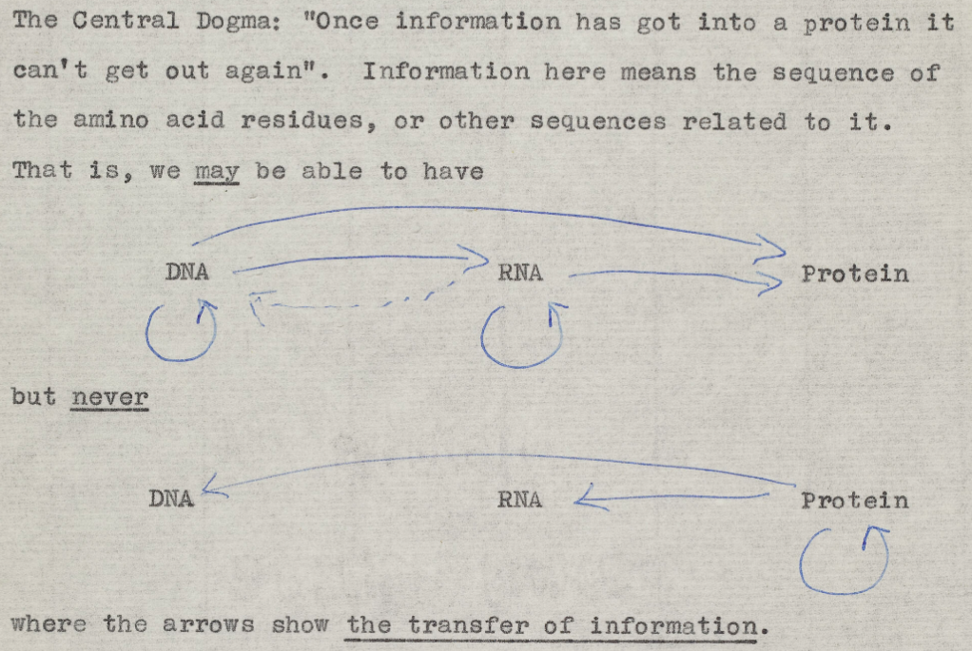
The Double Helix and Central Dogma
4

Slide 5
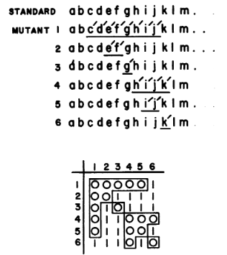
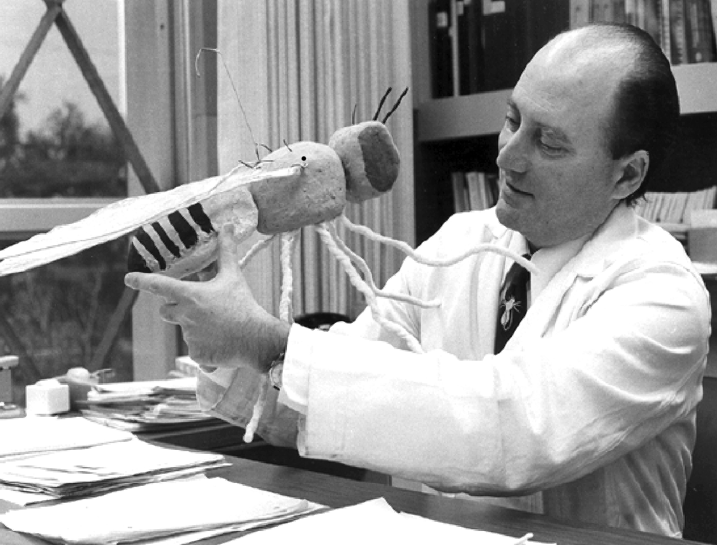
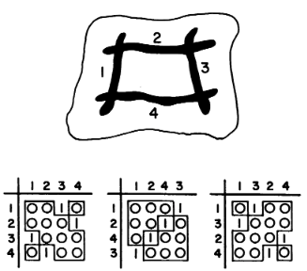
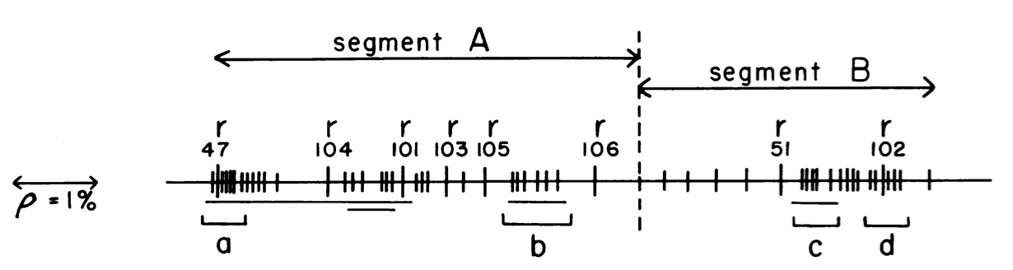
Benzer’s Experiment on Phage
 | E.coli Strand B | E.coli Strand K
Wild Type | Grow. | Grow.
Mutant | No growth. | Rapid lysis.
(E.Coli is the abrriviation of Escherichia coli)
5

Slide 8
Benzer’s Experiment on Phage
 | E.coli Strand B | E.coli Strand K
Wild Type | Grow. | Grow.
Mutant | No growth. | Rapid lysis.
(E.Coli is the abrriviation of Escherichia coli)
5

Slide 9
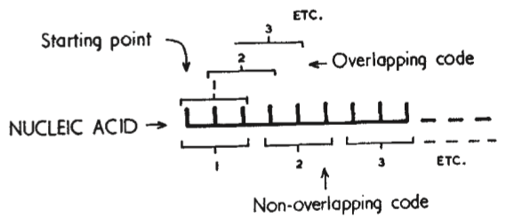
DNA Codes in a Non-overlapping Way
If overlap and the codes are triplets, than an amino acid can only be followed by a few other amino acids.
Studies on hemoglobin shows that the single nucleotide change only cause mutation of a single amino acid (instead of three).
6

Slide 10
Selecting the Correct Sets
A ‘comma’ base to separate the sets.
Only some of the nucleotide sets make sense.
There is a fixed starting point.
ABC (D) CBA (D) BCA (D)…
ABC (CCAB) BAC (DA) BAC (CA)…
(ABC) BAC CDA ADC BAC …
7
Notes:
】

Slide 11
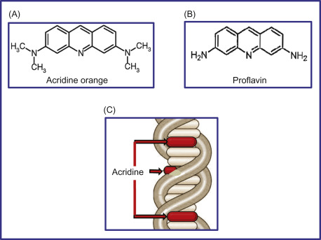
Acridine induce non-leaky mutations
Non-leaky mutations: gene is completely shut down.
They suspect that Acridine introduce additions into the genome.
8

Slide 12
The Experiment
9

Slide 13
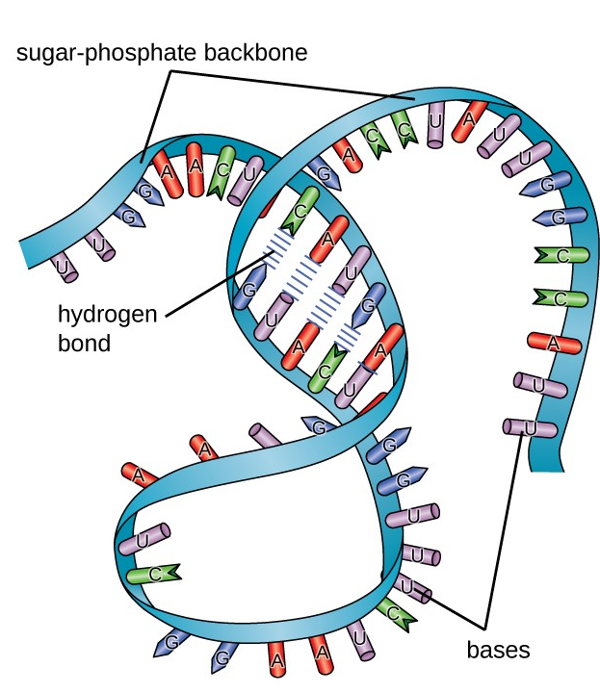
Experiment Started
Francis Crick had an idea…
And wanted to prove it with the r_{II} phage system.
The message RNA can fold back on itself and the bulk parts carries the message.
10

Slide 14
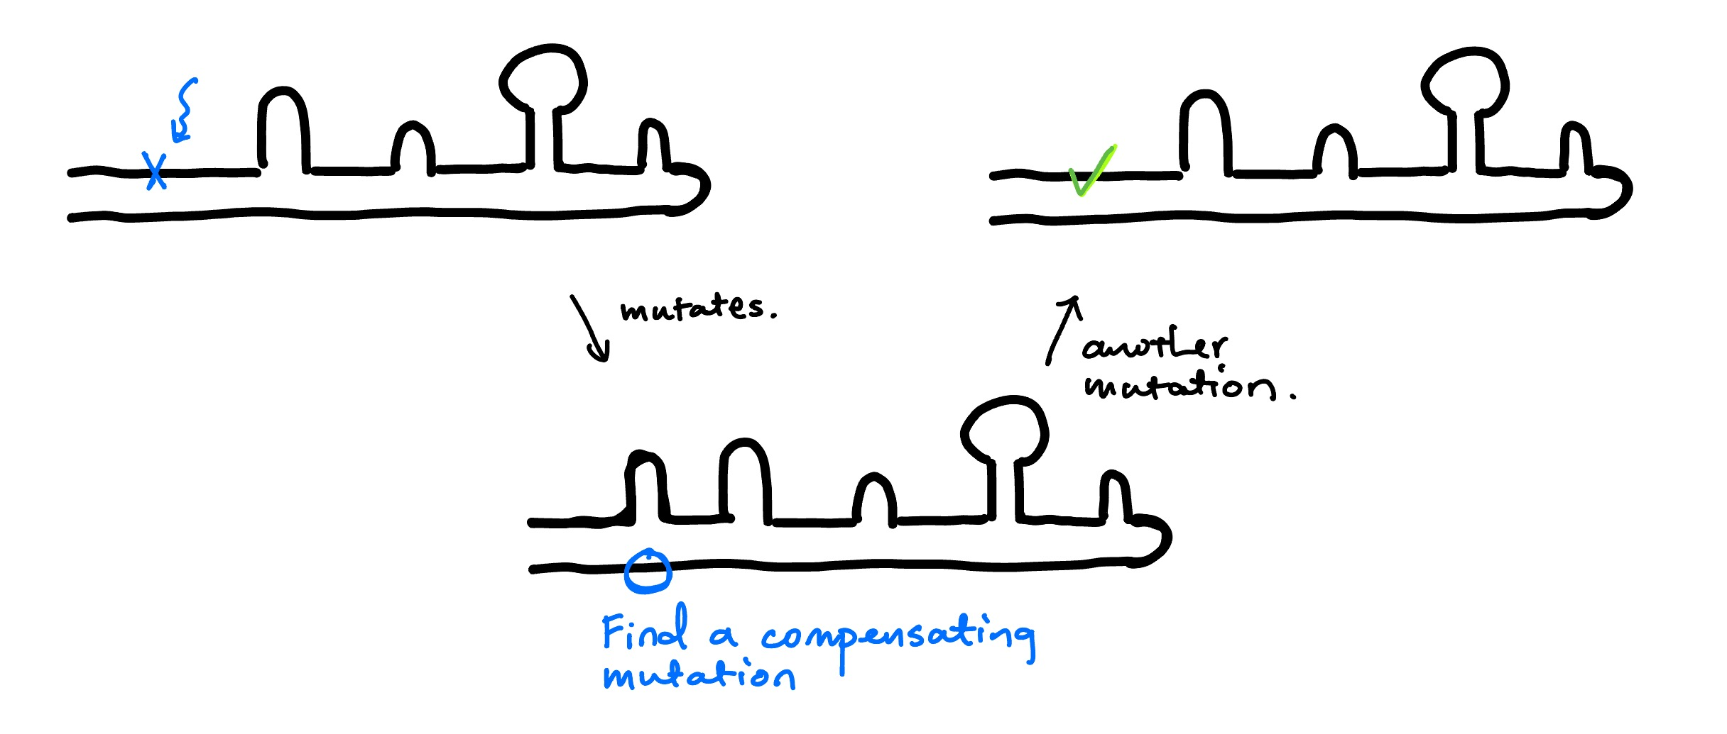
He thinks…
All mutations and their reverts should (if he is correct) be symmetric around the bending point.
11

Slide 15
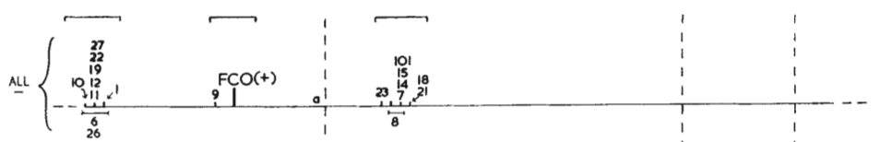
He finds…
Reverts are on the same gene and are not distributed as predicted.
12

Slide 16
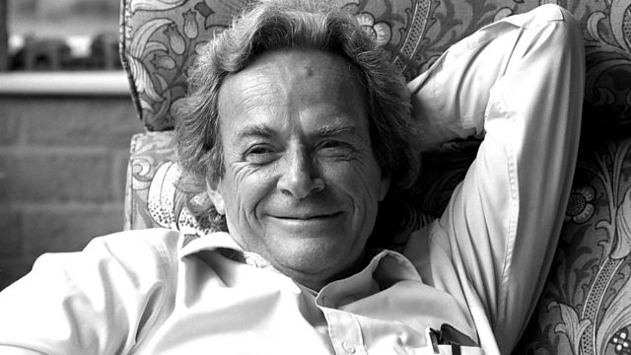
Actually, an old friend knows this…
13

Slide 17
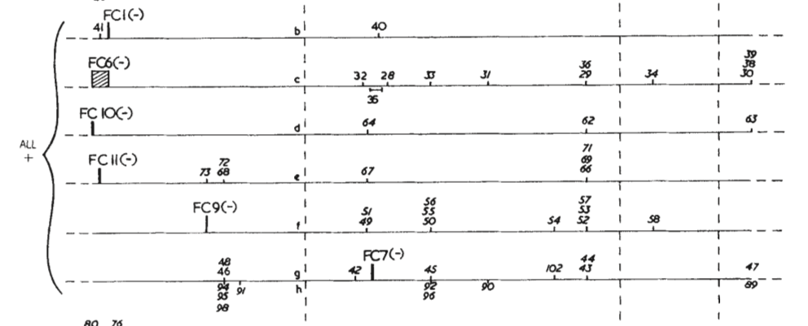
He was not happy…
So he went on to find suppressors of suppressors…
14

Slide 18
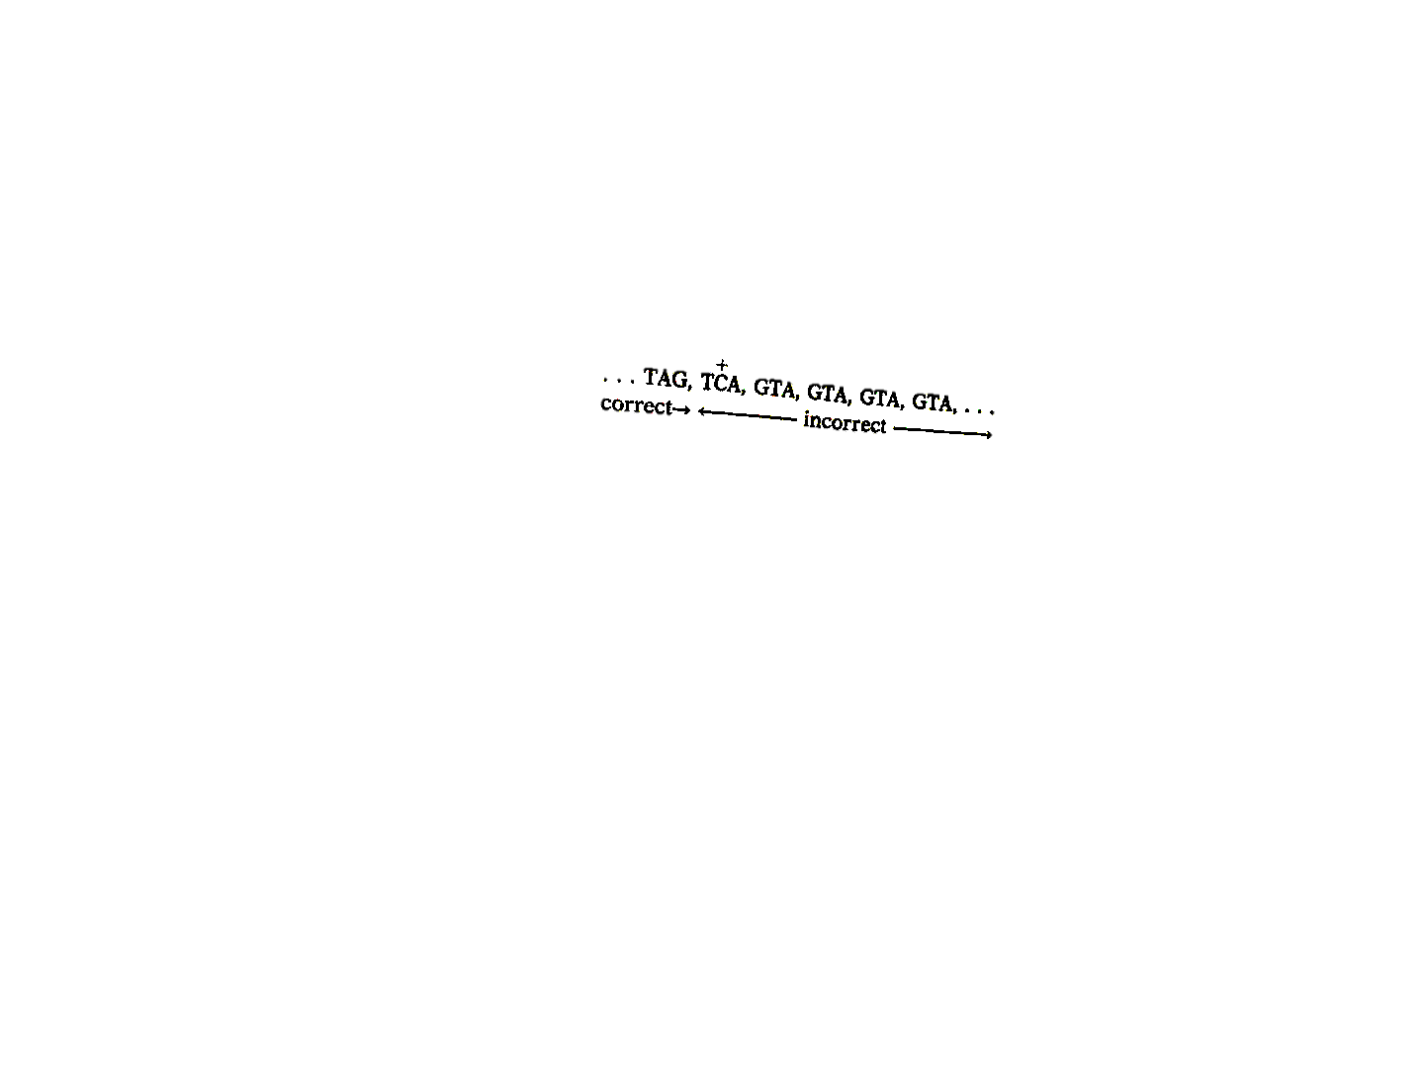
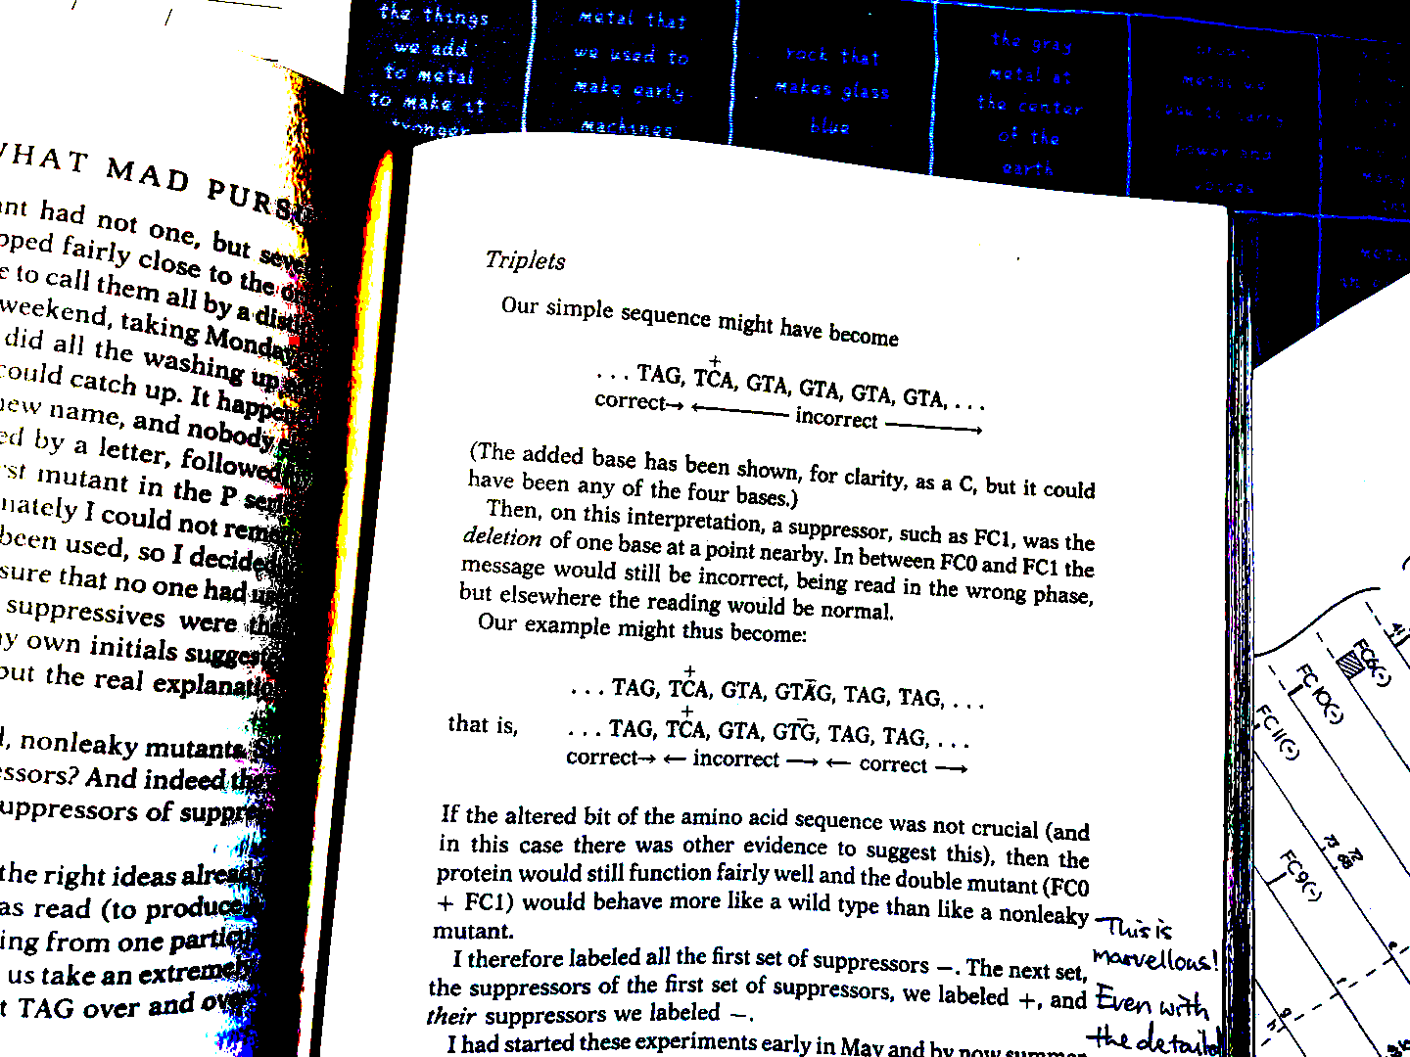
He finally reallized…
And he reallized this can be used to study the triplet condon.
15

Slide 19
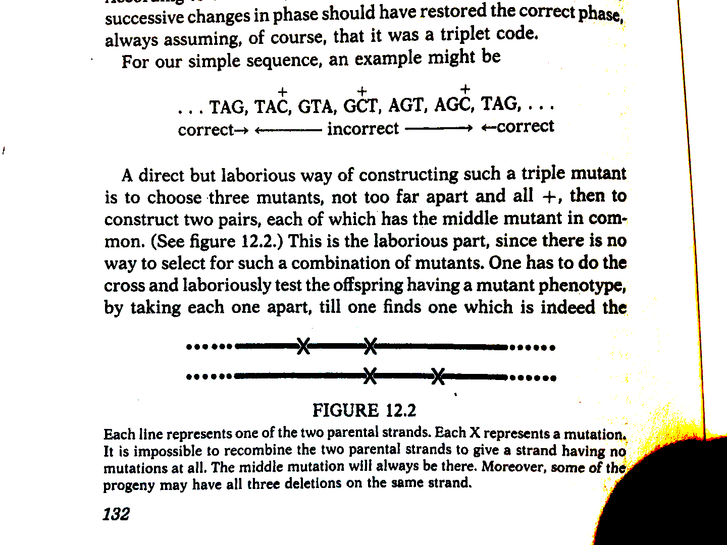
The rest we probably all learnt.
16

Slide 20
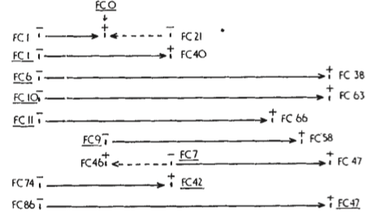
They also predicted the ‘stop codon’.
Why don’t suppressors cover the whole of the gene?
They suspect that some mutations cause the existance of ‘unacceptable’ codons. Which will terminate the gene’s function.
17

Slide 21
Conclusions
18

Slide 22

Final remarks…
The codons are most likely to be in a triplet form.
What you find might not be what you expected.
They can probably do one more experiment…
Go and read What Mad Pursuit by Francis Crick!
19

Slide 23
Appreciate your interest!
Any questions?
20

